Slide 1
Running on Empty:
Singapore's Hidden Sleep Crisis
How Singapore Sleeps 2026:
A Sleep Health Survey commissioned by The Air Station & Easmed
n=1,000 Singapore office workers | Aged 30–60 | July 2026 | Research by Milieu Insight

Slide 2
© 2026 Easmed Pte Ltd and The Air Station. All rights reserved.
This report and its contents, including survey findings, data, charts, graphics, analysis and commentary, are proprietary to Easmed Pte Ltd and The Air Station Pte Ltd.
The report may be downloaded and referenced for personal, educational, editorial and non-commercial purposes provided that “How Singapore Sleeps 2026, jointly commissioned by Easmed and The Air Station” is clearly cited as the source.
Reproduction, republication, redistribution, modification, commercial use, incorporation into commercial presentations or reports, or use of the survey data for marketing, product promotion or commercial research requires prior written permission from Easmed and The Air Station.
For permissions and data enquiries: mktg.sg@easmed.com

Slide 3
SLEEP SURVEY QUESTIONS
Questionnaire covered sleep habits, OSA awareness and risk, workplace impact, screening behaviour and employer support.
n = 1,000 workers
1 PROFILE & WORK
2 SLEEP DURATION & QUALITY
3 OSA AWARENESS & BELIEFS
4 OSA WARNING SIGNS
• Height and weight
• Hours slept on a typical work night
• Familiarity with obstructive sleep apnea
• Loud snoring
• Work environment / job type
• Hours needed to feel refreshed
• Beliefs about snoring, daytime sleepiness, breathing pauses and 'needing little sleep'
• Daytime tiredness / sleepiness
• Overall sleep quality
• Witnessed breathing pauses, gasping or choking
• High blood pressure / treatment
5 SLEEP & WORK HABITS
6 SCREENING & BARRIERS
7 WORKPLACE IMPACT
8 EMPLOYER SUPPORT
• Cutting sleep short for work demands
• Doctor discussion, tracker/wearable, sleep study, prior diagnosis
• Estimated productivity drop after poor sleep
• Sleep health education / workshops
• Checking work emails/messages in bed
• Barriers: cost, access, time, seriousness, embarrassment and fear of diagnosis
• Frequency of poor concentration / focus
• Subsidised sleep screening / testing
• Irritability, low mood or short temper
• Flexible hours
• Quiet rest space
Response formats included single select, multi-select and open response. OSA risk indicators were captured through symptom and physical-factor questions.

Slide 4


Respondent Profile
Gender | Age Group | Ethnicity
Highest Education | Office Situation | BMI Range
Respondent Profile | Base: All completed respondents (n=1,000)
4

Slide 5

The Crisis in Five Numbers
Singapore's workforce is paying a steep, silent price — and most don't know why.
97%
1 in 4
60%
Productivity Loss
OSA Risk
Cannot Describe OSA
of workers lose productivity after a poor night's sleep
screen at meaningful risk of Obstructive Sleep Apnea (OSA)
have no idea what OSA is — awareness is low
56%
58%
Never Screened
20%+ Drop
have never had their sleep checked — in any way
say their productivity falls by more than 20% after poor sleep
The data is already here. The cost is already being paid. The question is whether employers are measuring it.

Slide 6

CHAPTER 1
How Singapore Sleeps
A nation of early risers running on chronically insufficient rest — the numbers reveal a workforce that is structurally sleep-deprived.

Slide 7
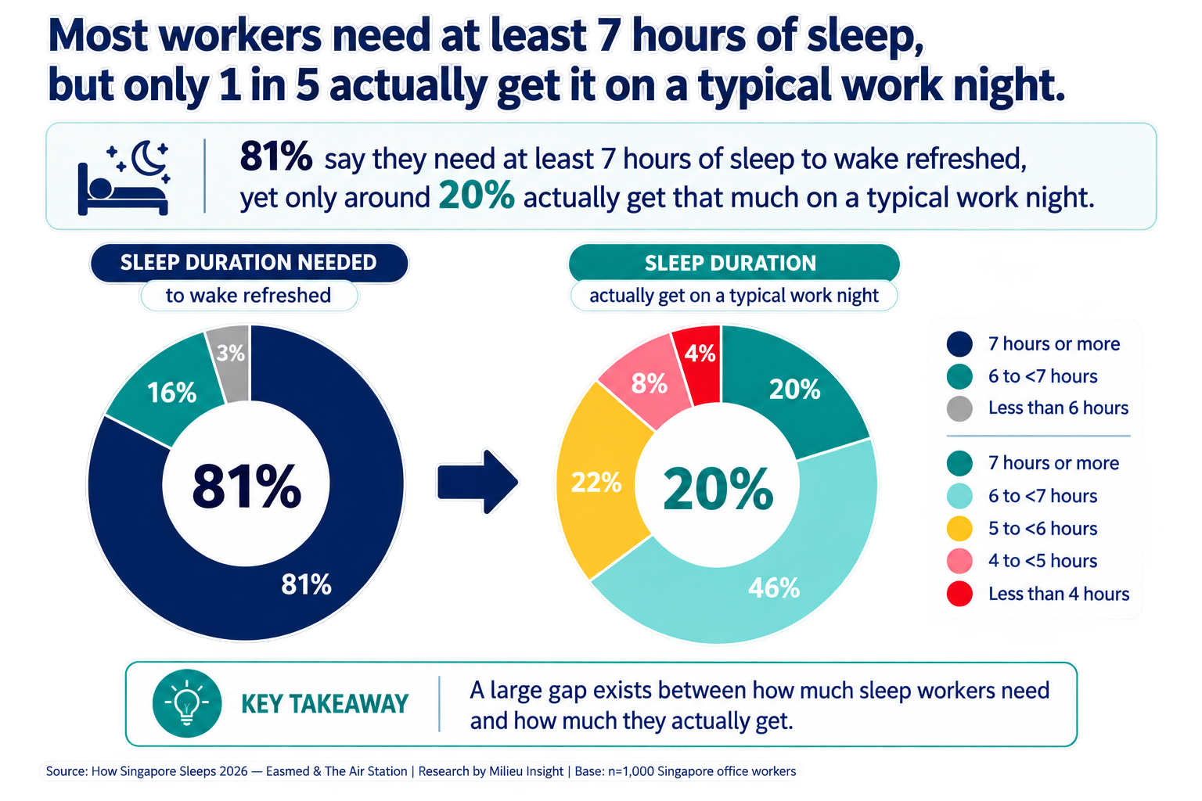
Singapore Workers start workday with a 1.1 hour sleep deficit
Workers don’t get what they need.
7.4 hours is needed for most to feel rested. But only 6.3 is achieved.
81% say they need at least 7 hours of sleep to wake refreshed.
Yet only 20% get that much on a typical work night
Source: How Singapore Sleeps 2026 — Easmed & The Air Station

Slide 8
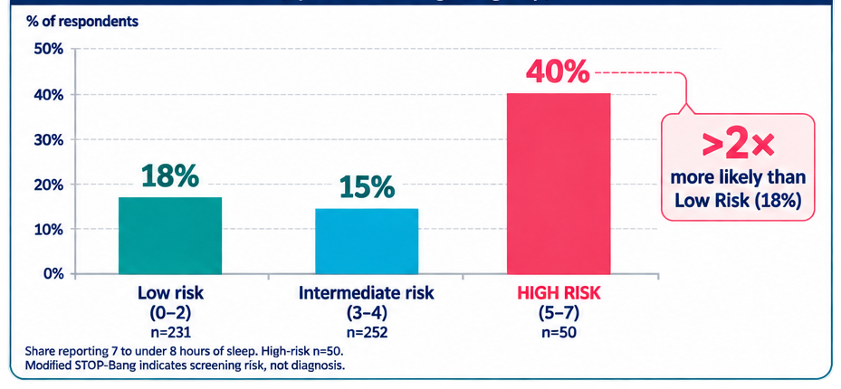
Adequate Sleep Duration doesn’t mean Healthy Sleep
SLEEPING ENOUGH?
40% of HIGH-RISK workers report 7–<8 hours
STILL AT RISK.
The highest-risk group reports the longest average sleep duration
THE HIDDEN SLEEP RISK
Enough hours can create false reassurance.
Source: How Singapore Sleeps 2026 — Easmed & The Air Station

Slide 9
The Highest-Risk Workers Feel Fine. That's the Problem.
The most OSA at-risk workers rate their sleep better, not worse.
Low Risk
High Risk
IMPLICATION
29% rate sleep as Good/Very Good
Aware of deficits, seeking improvement
34% rate sleep as Good/Very Good
Confidence is the danger — OSA masks itself completely
Self-reported experience alone can’t reliably sort risk tiers, reinforcing the case for a validated screener over self-report.
Asking "how do you sleep?" will not surface your highest-risk employees.
The condition hides in plain sight — and in self-satisfaction.

Slide 10
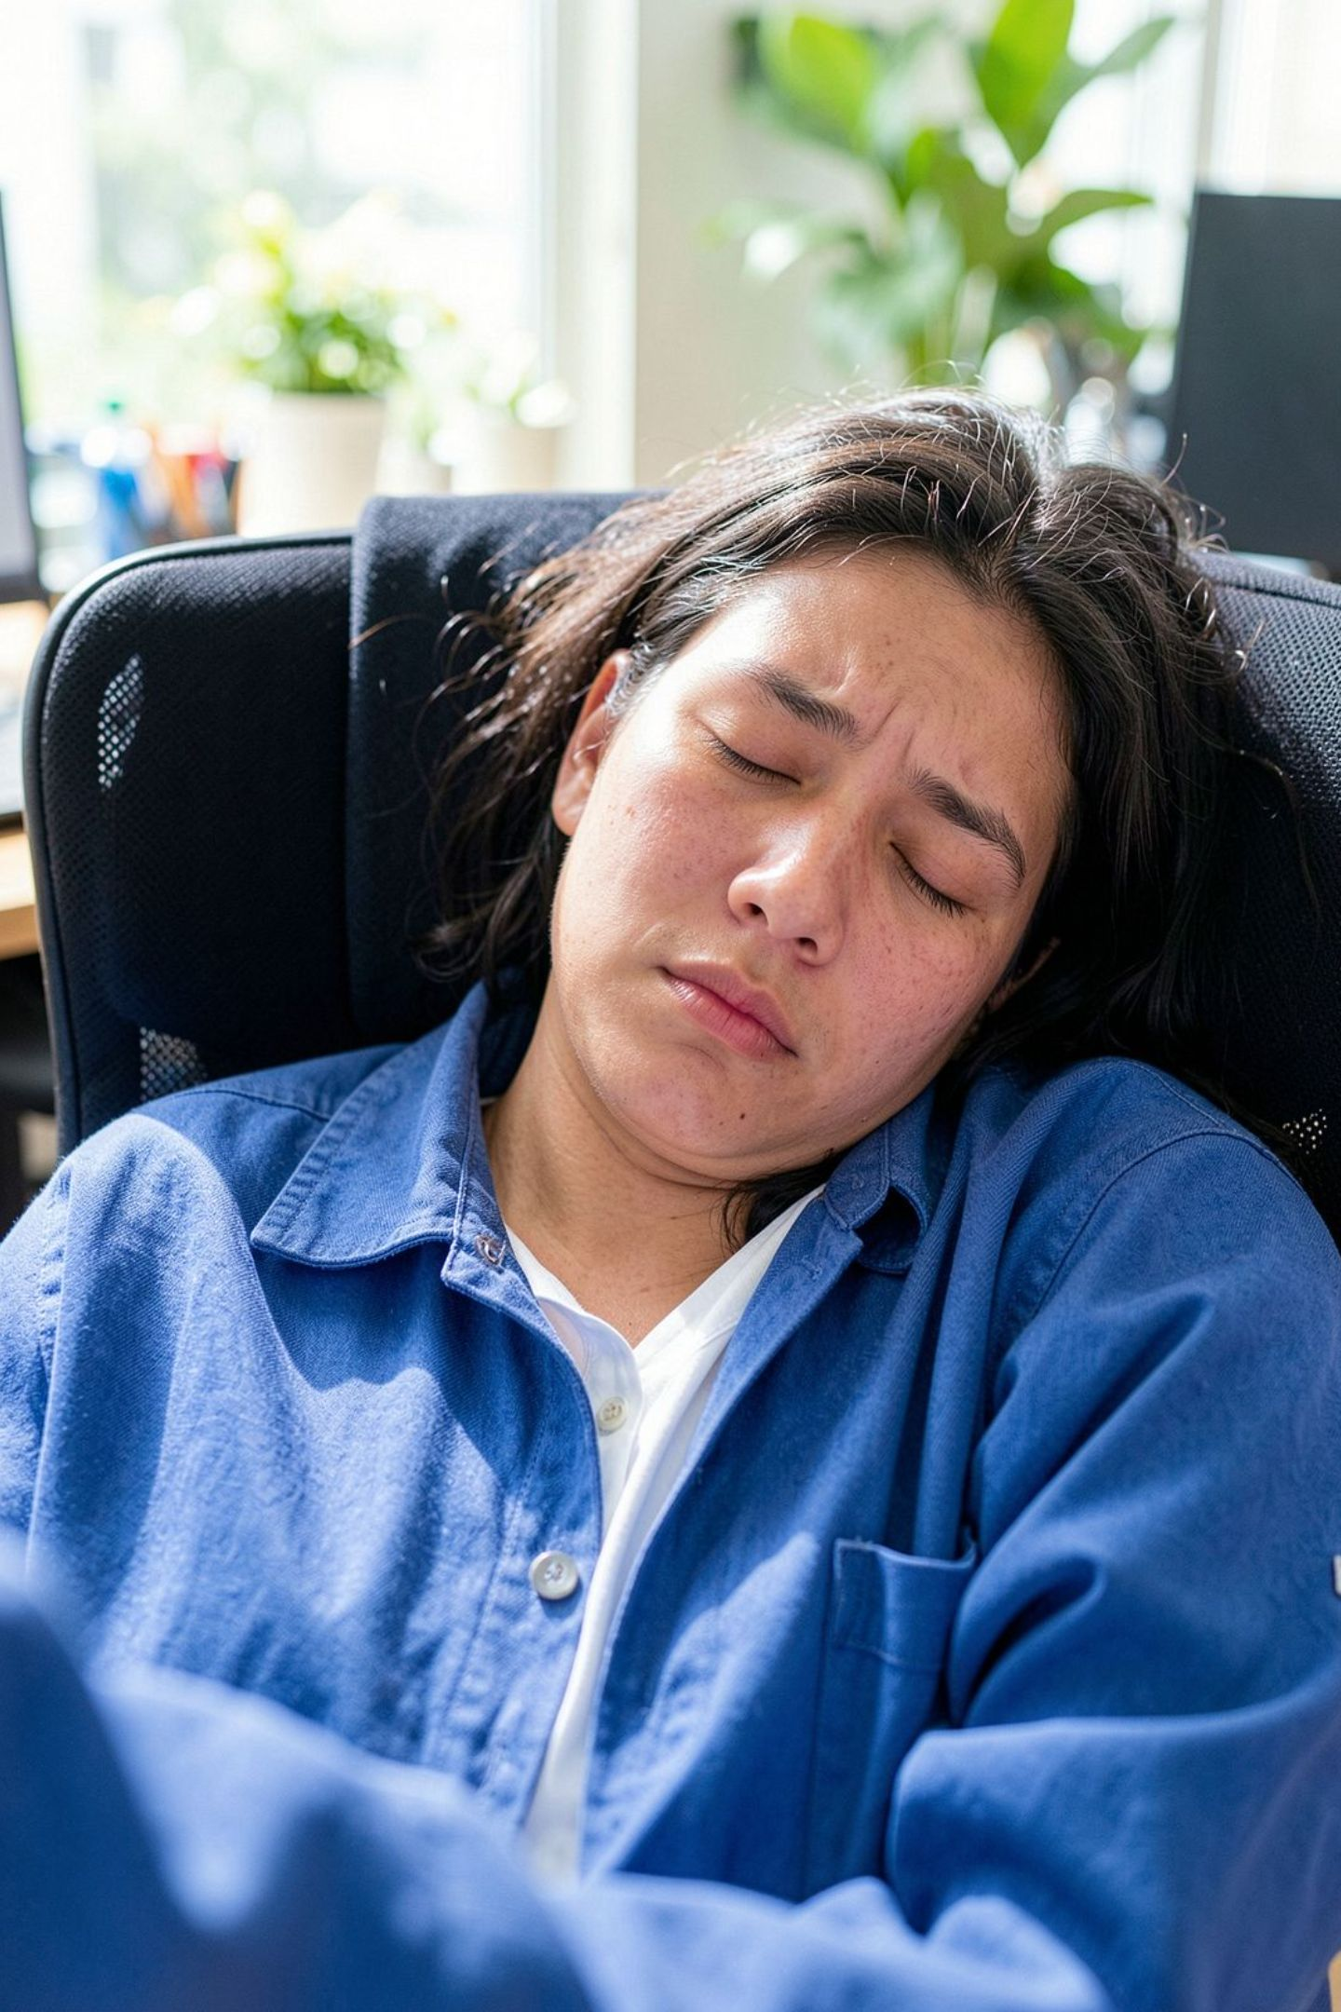
CHAPTER 2
Awareness, Myths & Real Risk
When 60% of workers cannot name the condition affecting 1 in 4 of them, dangerous myths fill the vacuum — and OSA goes undiagnosed for years.

Slide 11
60% Don't Know What OSA Is — and Dangerous Myths Fill the Gap
Awareness arrives after symptoms, not before. Only 40% of workers can describe what Obstructive Sleep Apnea is. The rest are operating on myths — and those myths have real clinical consequences.
Beliefs about Sleep & Snoring | Strongly Agree OR Agree | Strongly Disagree OR Disagree
 | Base: Overall (n=1000)
Getting enough sleep is essential to performing well at work. | 98% | 2%
Loud, regular snoring is usually a sign of deep, healthy sleep. *This option is reverse-coded; “disagree” is the desired answer. | 24% | 76%
Feeling sleepy during the day is just a normal part of a busy working life. | 50% | 50%
Brief pauses in breathing during sleep are harmless because the body always wakes you up. | 25% | 75%
Needing little sleep is a sign of being committed and hardworking. | 19% | 81%
OSA Awareness
Base: Overall (n=1000)
I have never heard of it
I know roughly what it is
I have heard the name, but don’t really know what it is
I know it well / have personal or family experience
60% do not know what OSA is
40% know what OSA is
Source: How Singapore Sleeps 2026 — Easmed & The Air Station
These myths are not harmless opinions. They are the reason OSA goes undiagnosed for years.

Slide 12
The Warning Signs Are Already There
These are not projections. These are today's numbers, in Singapore's offices, right now.
1 in 4
1 in 8
Loud Snorers
Witnessed Pauses
Snore loudly enough to be heard through a closed door
Have had a partner witness them stop breathing during sleep
36%
20%
Men Who Snore Loudly
Men: Witnessed Pauses
vs. only 13% of women — a stark gender disparity in visible symptoms
vs. 6% of women — men are disproportionately at risk and disproportionately unscreened
The clinical signals are present. The diagnosis is absent.

Slide 13
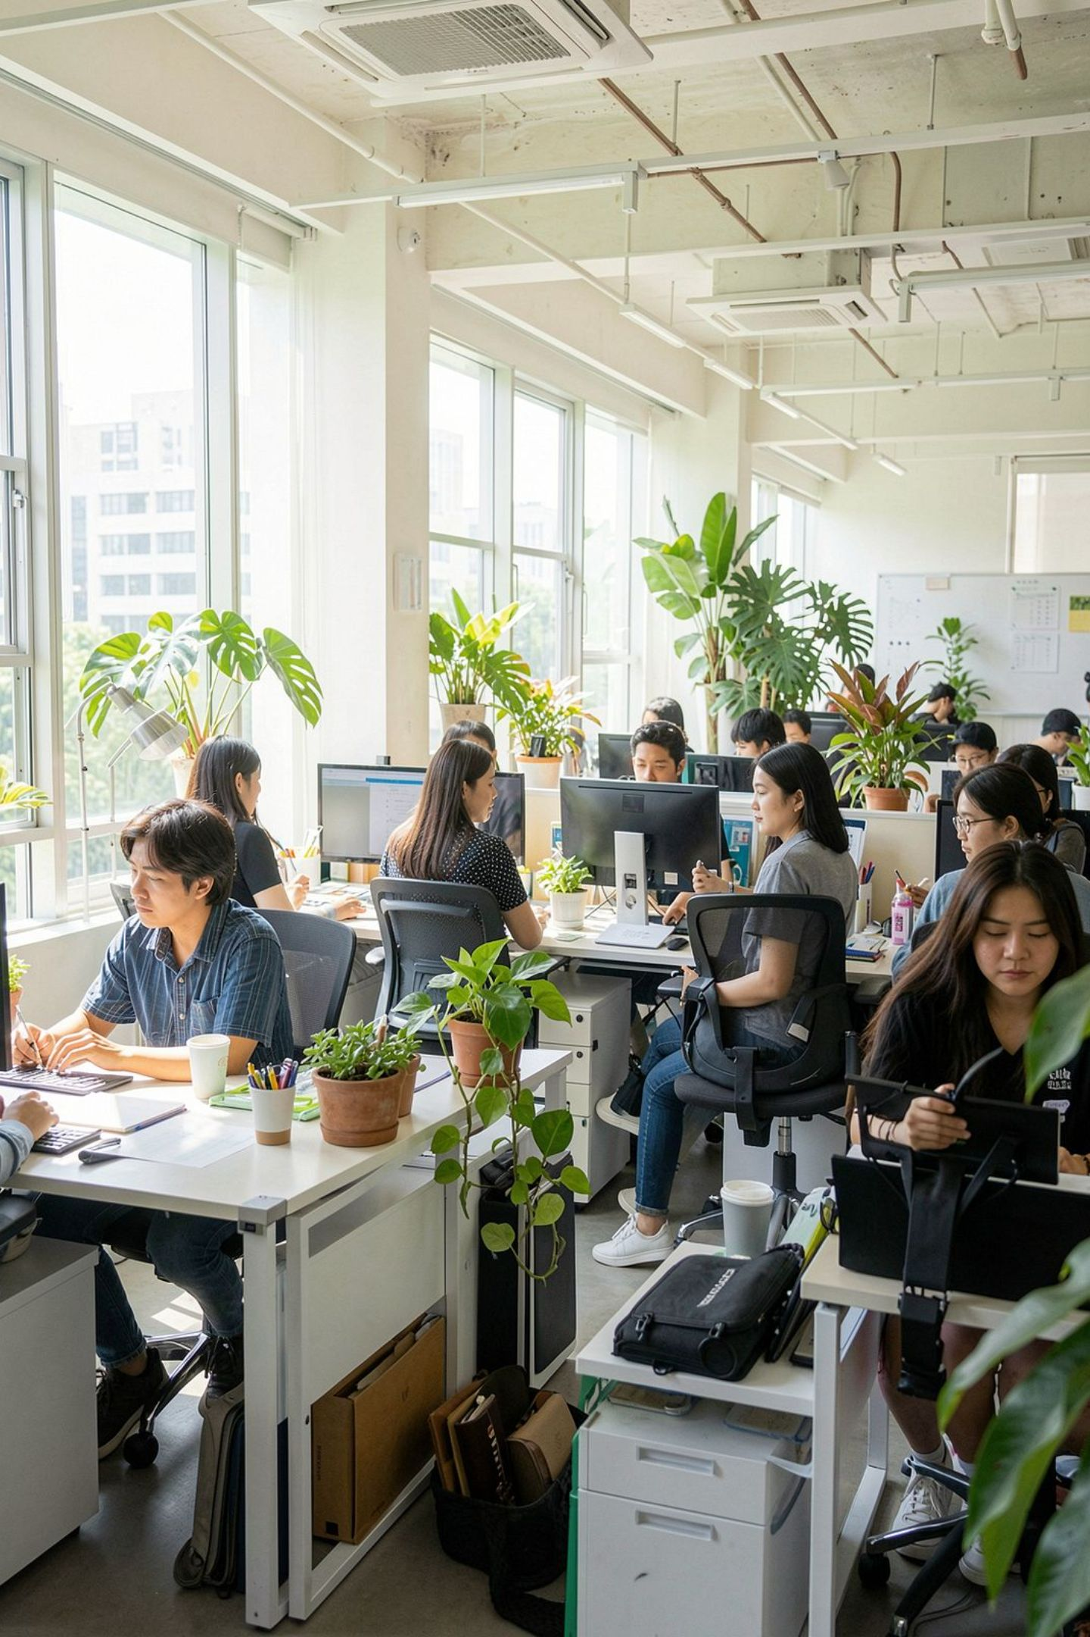
CHAPTER 3
Sleep's Cost at Work
The productivity loss is real, measurable, and already being paid.
Most employers are simply not measuring it.

Slide 14
Work is following Singaporeans into Bed
71%
1 in 4
7 in 10 have sacrificed sleep to keep up with Work Demands
Check work emails/message in bed
at least 3-4 times a week
38%
12%
Cutting sleep short at least once a week for work
Check work emails/message in bed
Almost every day
Poor sleep isn't just about bedtime habits. For many workers, work itself is competing with sleep.

Slide 15
Employers Are Paying for Poor Sleep — Without Knowing It
Productivity Impact of Poor Sleep
The Employer Blind Spot
97%
The cost is real, measurable, and already being paid. Most employers are not measuring it. That changes with a screening programme.
Report a productivity drop after poor sleep
58%
The High-Risk Paradox
Say that drop exceeds 20% — a material business impact
OSA High-risk workers are most likely to say poor sleep has no impact — the same desensitisation that conceals their condition. This is the third self-reported measure that understates this group’s risk rather than revealing it.
Source:
How Singapore Sleeps 2026 — Easmed & The Air Station

Slide 16
The cost of poor sleep shows up at work
Before it shows up in a diagnosis
Daytime & Mood Impact
Base: Overall (n=1000)
Concentration and mood both take a weekly hit for >50% of the workforce, another sign that under-recognized Sleep Health Issues are already shaping how people work.
Harder to concentrate or stay focused at work
Feel irritable, low, or short-tempered
Source: How Singapore Sleeps 2026 — Easmed & The Air Station

Slide 17

CHAPTER 4
Screening Gaps & the Employer Opportunity
The barriers to screening are structural, not personal. Employers are uniquely positioned to remove them.

Slide 18
56% Have Never Had Their Sleep Checked
Sleep Screening & Help-Seeking Behaviours
Barriers to Diagnosis & Treatment
Source: How Singapore Sleeps 2026 — Easmed & The Air Station
Source: How Singapore Sleeps 2026 — Easmed & The Air Station
The Fix Is Straightforward
A subsidised, clearly signposted screening programme addresses both dominant barriers simultaneously — for every risk band, every demographic, every level of health literacy.
Cost and navigation are the dominant barriers — structural, not personal, and fixable by employers.

Slide 19



Workers Ask for Flexibility. They Need Screening.
The most popular employer ask and the most effective employer intervention are not the same thing. Conflating them leaves high-risk workers unsupported.
72%
Want Flexible Hours
37%
Want Subsidised Screening
21%
Want Sleep Education
The top employer ask — but high-risk workers already sleep as much or more than others. More time in bed won't fix disrupted breathing.
The intervention that actually identifies the condition — cost-effective, scalable, and directly targeted at the structural barrier workers cite most.
The awareness that drives screening uptake — without it, even subsidised programmes see low engagement from the groups who need them most.
Flexible hours is not a treatment. Screening is. Employers who invest only in flexibility are solving the wrong problem.

Slide 20

CHAPTER 5
Who Is Most at Risk?
Different segments carry different risk profiles, different myths, and different barriers. One-size-fits-all won't work.

Slide 21
Chinese Workers: The Mainstream Profile
At 90% of the sample, Chinese workers mirror the overall population on sleep, risk, and awareness — with one critical standout that shapes how employers should sequence their interventions.
At 90% of the sample, Chinese figures are the overall figures.
Sleep Quality (rated Good/Very Good):
26% (vs. overall 27%)
OSA Awareness (know it well):
6% (vs. overall 6%)
Productivity Drop >20% After Poor Sleep
59% (vs. overall 58%)
Never Screened for Sleep Issues
57% (vs. overall 56%)
Want Flexible Hours from Employer
73% (vs. overall 72%, sig. higher than Non-Chinese 62%)
38% (vs. 38% overall) cut sleep short for work at least 1-2x/week
Sleep & Work Behaviours
Checks email in bed almost daily: 11% (vs. 12% overall)
Cuts sleep short almost daily: 5% (vs. 5% overall)
Barriers to Diagnosis
Cost of diagnosis/treatment: 51% (vs. 51% overall)
Don’t know where to go: 35% (vs. 36% overall)
BELIEFS ABOUT SLEEP & OSA
SLEEP & OSA SNAPSHOT
BARRIERS TO DIAGNOSIS
Getting enough sleep is essential to work: 98% agree (vs. overall 98%)
Loud snoring = healthy sleep (myth): 23% agree (vs. overall 24%)
Breathing pauses are harmless (myth): 24% agree (vs. overall 25%)
Needing little sleep = hardworking (myth): 17% agree (vs. overall 19%)
EMPLOYER SUPPORT WANTED
Flexible hours to support better sleep | 73%
Quiet rest space at the workplace | 52%
Access to subsidised sleep screening | 36%
Partner noticed breathing pauses/gasping: 13%
High blood pressure or treated for it: 12%
Snores loudly enough to be heard: 24%
OSA WARNING SIGNS REPORTED
SCREENING BEHAVIOUR
Symptom prevalence sits far below the high-risk group’s across the board.
Spoken to a doctor about sleep: 9%
Used a sleep-tracking app: 34%
Had a formal sleep study/test: 7%

Slide 22
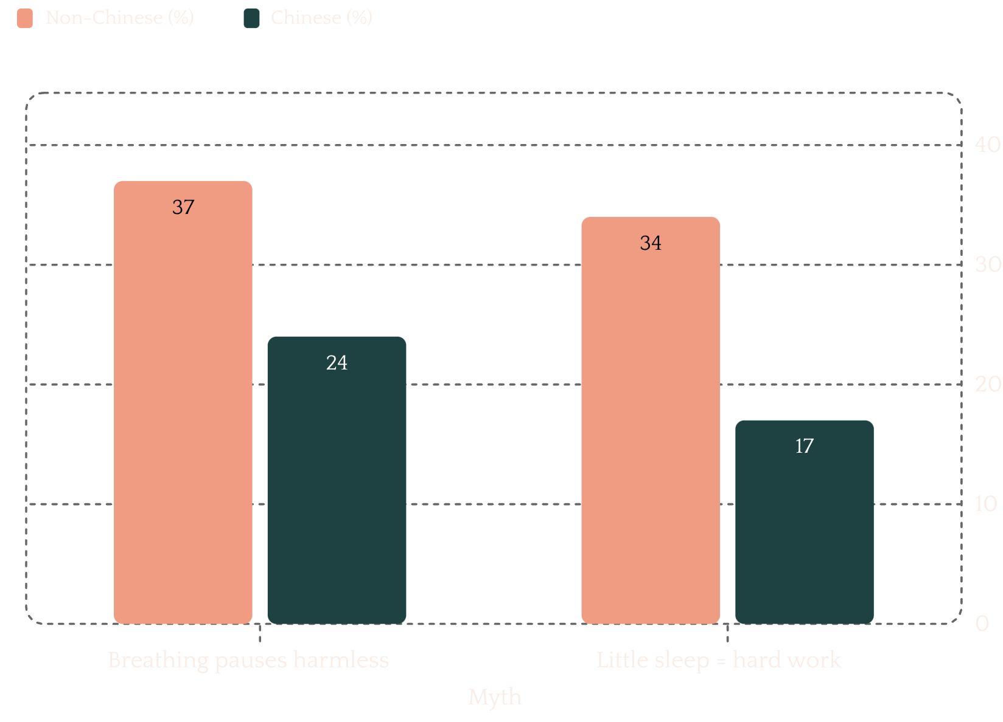

Non-Chinese Workers: Myths Run Deeper Here
Non-Chinese workers carry measurably higher myth loads — nearly double the Chinese rate on several dangerous beliefs. Education must precede screening for this segment to work.
Breathing Pauses Are Harmless
37% of Non-Chinese workers hold this belief — vs. 24% of Chinese workers. A 13-point gap that represents a direct barrier to seeking care.
Little Sleep = Hard Work
34% believe needing little sleep is a badge of diligence — vs. 17% of Chinese workers. This myth actively discourages help-seeking.
Navigation Barrier Is Acute
Leading structural barriers: cost (45%) and not knowing where to go (42%). Both are higher than the overall average — and both are fixable.
Recommended Action: Lead with myth-correction and education — before screening. Awareness must come before uptake.
Source: How Singapore Sleeps 2026 — Easmed & The Air Station

Slide 23
OSA-at-Risk Workers: The Condition Hides in Plain Sight
The group most urgently in need of intervention is the group least likely to self-identify as having a problem. Clinical signals are extreme — subjective awareness is not.
Clinical Red Flags
Subjective Disconnect
98% snore loudly. 88% have high blood pressure. 86% have had a partner witness breathing pauses. The signals are unambiguous.
Yet 34% rate their sleep as Good/Very Good. OSA is invisible to those carrying it — self-assessment is structurally unreliable for this group.
Myth Amplification
Embarrassment Barrier
Dangerous beliefs run 2–3× the overall rate in this group — the condition that most urgently requires screening is also the condition that most aggressively resists it.
20% cite embarrassment as a barrier — vs. 6% overall. Confidential, opt-in pathways are essential. Mandatory referrals will drive this group away.

Slide 24
The Time to Act Is Now
Educate First
60% cannot describe OSA — awareness must come before screening uptake. Without it, even subsidised programmes will be underused by those who need them most.
Singapore's workforce is running on empty.
The data is in.
The cost is clear.
The solutions exist.
What remains is the decision to act.
Subsidise Sleep health access
Remove the cost and navigation barriers that stop 56% of the workforce from ever getting checked. Incorporate Sleep Screening into workforce welfare programs. Increase access to sleep health help channels.
Tailor Your Approach
Different segments need different entry points.
Chinese workers want flexibility paired with screening.
Non-Chinese workers need education first. OSA-at-risk workers need confidentiality. One-size-fits-all won't work.
For media enquiries and corporate partnership discussions, contact
+6594750526 WhatsApp or Email to: mktg.sg@easmed.com
This report was commissioned by The Air Station and Easmed to advance awareness of sleep health and OSA in Singapore's workforce.

Slide 25
For media enquiries and corporate partnership discussions, contact
+6594750526 WhatsApp or Email to: mktg.sg@easmed.com
This report was commissioned in 2026 by
The Air Station Pte Ltd and Easmed Pte Ltd
to advance awareness of sleep health and OSA in Singapore's workforce.

